Slide 1

Arabic Sentiment Analysis
Supervised by:
Ali Alkhathlan

Slide 2
Content
Preview ​
Training ​
Result of restaurant data training​
Result of movies data training​
Result of hotels data training​
Information observed​
Inference​
GUI design (prototype)
Notes:
Preview:
Introduction ​
Data preparation methods​
Bag Of Words (BOW) approach ​
CountVectorizer​
TF-IDF​
N-gram method​
Machine learning algorithms & experiment

Slide 3
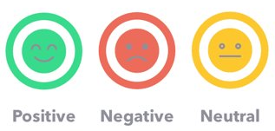
Sentiment Analysis
The use of Natural Language Processing (NLP) and Machine Learning to specify and extract subjective information in a piece of text. Sentiment Analysis is powerfully useful as it enables us to obtain an overview of the wider public opinions (e.g., happy, sad, and anger) towards certain topics, products or services.

Slide 4
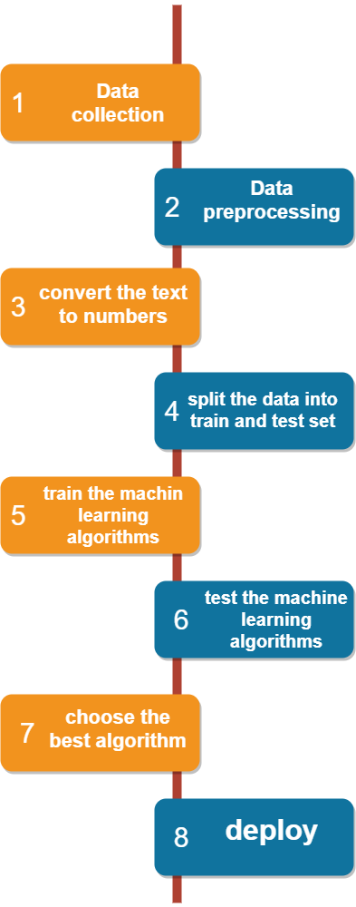
Roadmap (Project Framework)

Slide 5
Datasets
We used different data set in our project that include different reviews:
Hotel Reviews
Movie Reviews
Restaurant reviews
Consist of number of examples for each class: Positive, Negative, and Neutral.
The datasets are splitted into:
(0.9) present training and (0.1) present testing.

Slide 6
Number of examples
Data | Train | Test
hotels | 14015 | 1557
restaurant | 9873 | 1097
movies | 1372 | 152

Slide 7
Data Set & Data Preparation
Gather data.
Discover and assess data.
Cleanse and validate data.
Removing extraneous data and outliers.
Filling in missing values.
Conforming data to a standardized pattern.
Masking private or sensitive data entries.
Transform and enrich data.
Store data
Notes:
Attraction Reviews (tripadvisor, 2154 )
Hotel Reviews : ( booking , 409562 ) (tripadvisor, 15572 )
Movie Reviews (elcinema, 1524)
Product reviews (souq, 4272)
Restaurant reviews (tripadvisor, 10970)

Slide 8
CountVectorizer & TF-IDF
Counts the number of times each word appears in a document
Example : “this book is good”, “this movie is bad”, “the app is not good”.
“this book is good”
“this movie is bad”
“the app is not good”
Bag Of Words (BOW) approach
Notes:
Its like CountVectorizer but instead of Count the number of times each word appears in the document its TF*IDF score.
TF-IDF is an information retrieval technique that weighs a term’s frequency (TF) and its inverse document frequency (IDF). Each word or term that occurs in the text has its respective TF and IDF score. The product of the TF and IDF scores of a term is called the TF-IDF weight of that term.
Put simply, the higher the TF-IDF score (weight), the rarer the term and vice versa.

Slide 9






N-gram method
“التطبيق ليس جيد ”
1-gram
2-gram
3-gram

Slide 10
N-gram method
“the app is not good”
1-gram
2-gram
3-gram

Slide 11
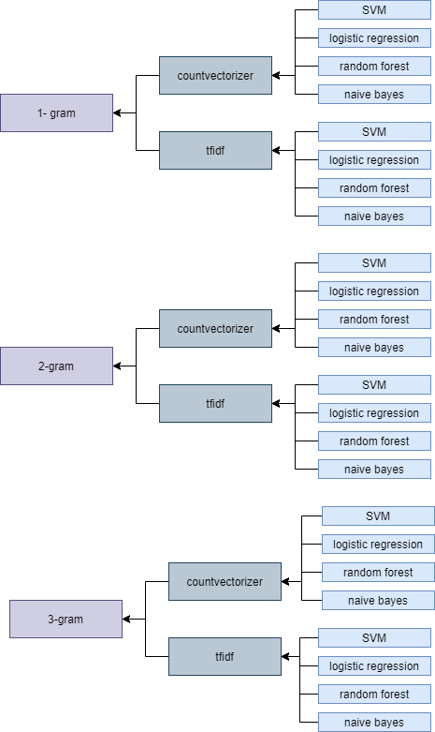
Experiments
We will not perform these algorithms from scratch, we will use some APIs to make it easy and fast. We will make 24 experiment and we will choose the best accuracy to use it in a GUI app.

Slide 12
Training
The models trained on separate data depend on the domain of the data.
Notes:
Preview:
Introduction ​
Data preparation methods​
Bag Of Words (BOW) approach ​
CountVectorizer​
TF-IDF​
N-gram method​
Machine learning algorithms & experiment

Slide 13
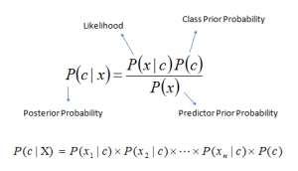
Naïve bayas
It is a classification algorithm based on Bayes’ Theorem
In simple terms, a Naive Bayes classifier assumes that the presence of a particular feature in a class is unrelated to the presence of any other feature.

Slide 14
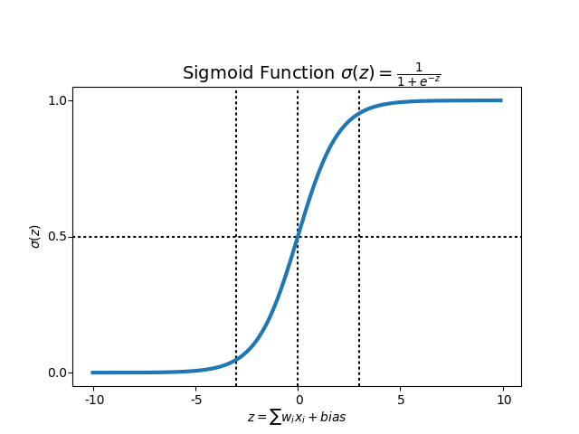
Logistic Regression
Logistic Regression is a classification Machine Learning algorithm, it is a predictive analysis algorithm and based on the concept of probability.
Logistic regression algorithm uses hypothesis and a sigmoid function to make a prediction, so what is hypothesis and sigmoid function.

Slide 15
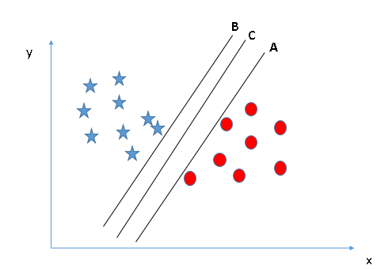
Support Vector Machine (SVM)
Support Vector Machine (SVM) machine learning algorithm which can be used for both classification or regression challenges. In the SVM algorithm, we plot each data item as a point, and we perform classification by finding the best decision boundary that differentiates the two classes very well.

Slide 16
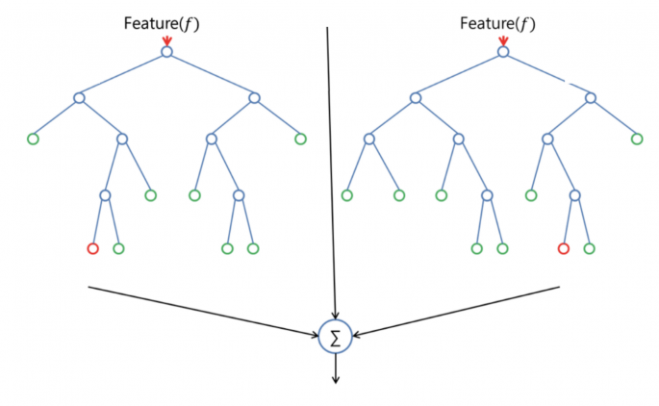
Random forest
Random forest is a classification algorithm, that use bagging method by combining a lot of decision trees together, that is why they call it forest.

Slide 17
Results of Training
Restaurant Data
Movies Data
Hotels Data
Notes:
Preview:
Introduction ​
Data preparation methods​
Bag Of Words (BOW) approach ​
CountVectorizer​
TF-IDF​
N-gram method​
Machine learning algorithms & experiment

Slide 18
Result of Restaurant Data​
CountVectorizer​
TF-IDF​
Algorithms \ N-Gram | 1-Gram​ | 2-Gram​ | 3-Gram​
Naive Bayas​ | 0.911738​ | 0.971338​ | 0.94859​
Logistic Regression​ | 0.953594​ | 0.982712​ | 0.984531​
SVM​ | 0.933121​ | 0.932666​ | 0.922202​
Random forest​ | 0.978617​ | 0.974977​ | 0.973612​
Algorithms \ N-Gram | 1-Gram​ | 2-Gram​ | 3-Gram​
Naive Bayas​ | 0.911738​ | 0.971338​ | 0.94859​
Logistic Regression​ | 0.953594​ | 0.982712​ | 0.984531​
SVM​ | 0.933121​ | 0.932666​ | 0.922202​
Random forest​ | 0.978617​ | 0.974977​ | 0.973612​

Slide 19
Result of Movies Data​
CountVectorizer​
TF-IDF​
Algorithms \ N-Gram | 1-Gram​ | 2-Gram​ | 3-Gram​
Naive Bayas​ | 0.627451 | 0.555556 | 0.287582
Logistic Regression​ | 0.679739 | 0.614379 | 0.594771
SVM​ | 0.594771 | 0.594771 | 0.594771
Random forest​ | 0.633987 | 0.607843 | 0.601307
Algorithms \ N-Gram | 1-Gram​ | 2-Gram​ | 3-Gram​
Naive Bayas​ | 0.647059 | 0.509804 | 0.27451
Logistic Regression​ | 0.673203 | 0.614379 | 0.601307
SVM​ | 0.594771 | 0.594771 | 0.594771
Random forest​ | 0.660131 | 0.640523 | 0.633987

Slide 20
Result of Hotels Data​
CountVectorizer​
TF-IDF​
Algorithms \ N-Gram | 1-Gram​ | 2-Gram​ | 3-Gram​
Naive Bayas​ | 0.802310​ | 0.817073​ | 0.740051​
Logistic Regression​ | 0.832477​ | 0.827343​ | 0.81258​
SVM​ | 0.765725​ | 0.709243​ | 0.69448​
Random forest​ | 0.759306​ | 0.731707​ | 0.722721​
Algorithms \ N-Gram | 1-Gram​ | 2-Gram​ | 3-Gram​
Naive Bayas​ | 0.793325​ | 0.785623​ | 0.688062​
Logistic Regression​ | 0.830552​ | 0.825417​ | 0.809371​
SVM​ | 0.787548​ | 0.716945​ | 0.695764​
Random forest​ | 0.761232​ | 0.739409​ | 0.733633​

Slide 21
Information Observed​
Countvectorizer and Logistic Regression are the winners all the time​
It seams that in sentiment analysis problems the CountVectorizer the most appropriate way to convert text to numbers​
Logistic Regression is better in classification problems than other algorithms specially when the number of features is large.

Slide 22
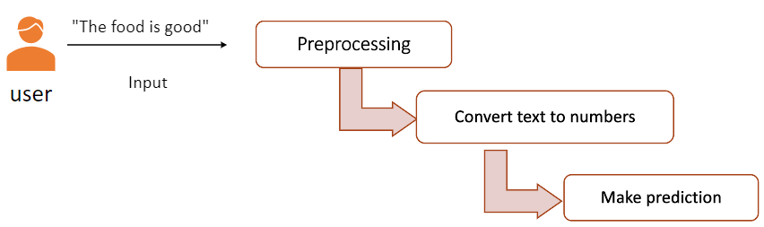

Inference​
The used approach in inference is pipeline.​
load the model and transformer objects as pickle file.​
Import a preprocessing function.​
And the chosen model is the highest f1-score

Slide 23
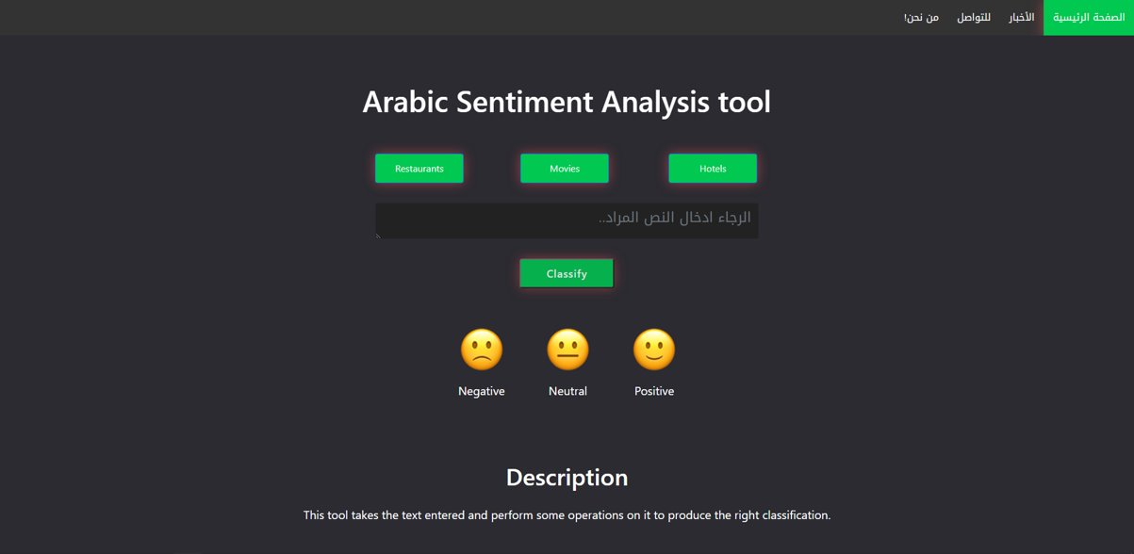
Prototype​

Slide 24
Thanks for listening!
Notes:
NumPy API, for linear algebra operation.
Scikit-learn API, for machine learning and conversion text to number algorithms.
Pandas API, for data preprocessing.

